Slide 1


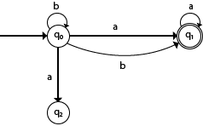


NFA

Slide 2


Non-deterministic Finite Automata
The finite Automata are called non deterministic finite automata if there exist many paths for specific input from current state to next state
It is easy to construct a NFA for a given language
Every NFA is not DFA, but every NFA can be translate into DFA
NFA is defined in the same way as DFA, but with two exceptions:
Multiple next states
It contains ε transitions
3

Slide 3
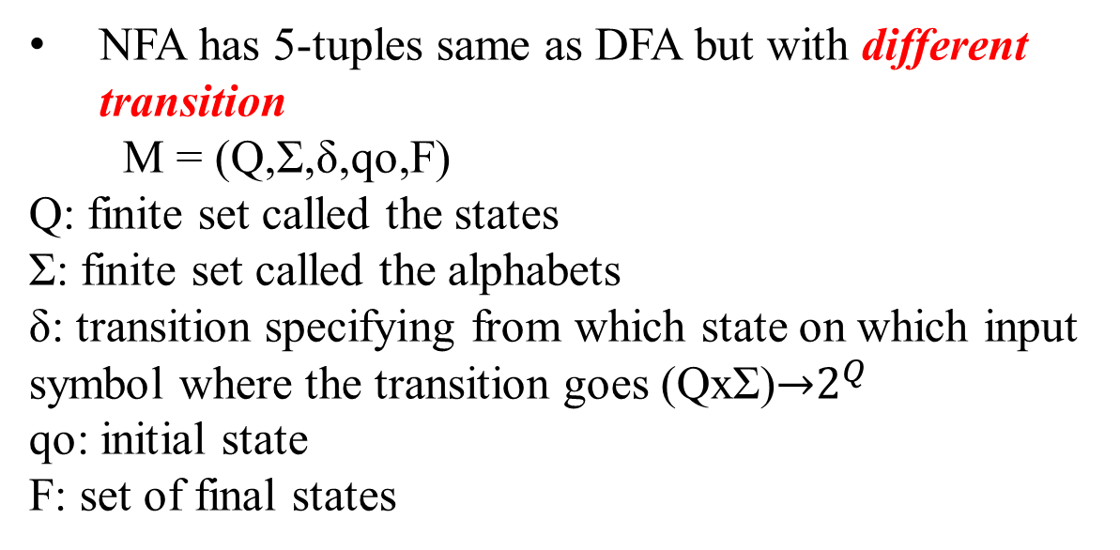
Definition of NFA
NFA has 5-tuples same as DFA but with different transition
M = (Q,Σ,δ,qo,F)
Q: finite set called the states
Σ: finite set called the alphabets
δ: transition specifying from which state on which input symbol where the transition goes (QxΣ)→$2^{Q}$
qo: initial state
F: set of final states
3

Slide 4
Difference between NFA and DFA
DFA | NFA
(q,a) ---single state | (q,a)-----multiple state
Single computation | Multiple computation
No ε transition | ε transition
Accepts computation and ends at an acceptable state | Accepts one of the computation path and ends at an acceptable state
3

Slide 5
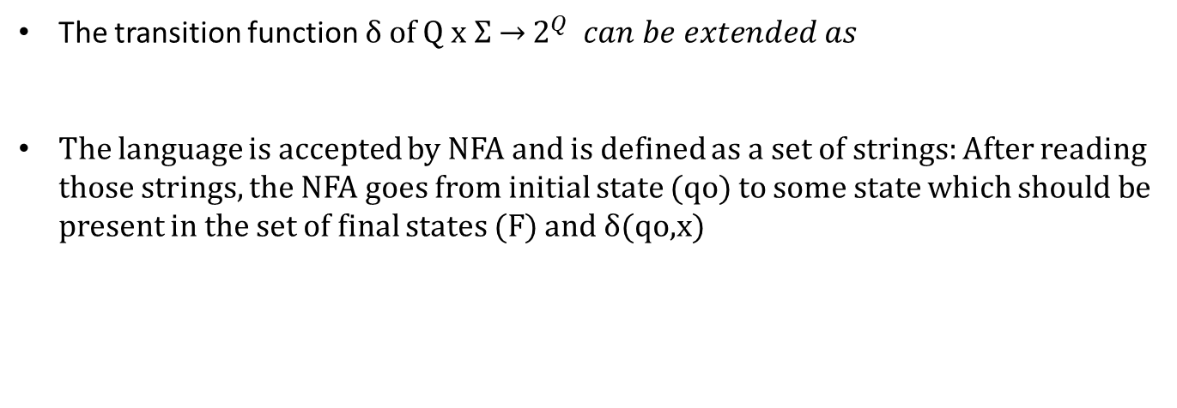
Language of NFA
The transition function δ of Q x Σ → $2^{Q} can be extended as$
The language is accepted by NFA and is defined as a set of strings: After reading those strings, the NFA goes from initial state (qo) to some state which should be present in the set of final states (F) and δ(qo,x)
3

Slide 6
Examples of NFA acceptance
Q. Consider the following NFA M=({qo,q1,q2,q3,q4},{a,b,c},δ,qo,{q4}) , where δ is defined:
For the input x = aca, check whether it is accepted by the machine
For the input x = cac, check whether it is accepted by the machine
3

Slide 7
States | a | b | c
3

Slide 8
States | a | b | c
qo | {qo,q1} | {q0} | {qo,q3}
q1 | {q1,q4} | {q1} | {q1}
q2 | {q2} | {q0,q2,q4} | {q2}
q3 | {q3} | {qo,q2,q4} | {q3,q4}
q4 | -- | -- | --
3

Slide 9
States | a | b | c
qo | {qo,q1} | {q0} | {qo,q3}
q1 | {q1,q4} | {q1} | {q1}
q2 | {q2} | {q0,q2,q4} | {q2}
q3 | {q3} | {qo,q2,q4} | {q3,q4}
q4 | -- | -- | --
3

Slide 10
States | a | b | c
qo | {qo,q1} | {q0} | {qo,q3}
q1 | {q1,q4} | {q1} | {q1}
q2 | {q2} | {q0,q2,q4} | {q2}
q3 | {q3} | {qo,q2,q4} | {q3,q4}
q4 | -- | -- | --
3

Slide 11
Q. Consider the input w=00101.Check whether it is accepted by the machine.
States | 0 | 1
qo | {qo,q1} | {q2}
q1 | ∅ | ∅
q2 | ∅ | ∅
3

Slide 12
States | 0 | 1
qo | {qo,q1} | {q2}
q1 | ∅ | ∅
q2 | ∅ | ∅
3

Slide 13
Q. Check whether the input string ‘w’ is accepted by the following automata.
i)w = 150
ii)w= 465
3

Slide 14
3

Slide 15
3

Slide 16
3

